Slide 1





Front-end development for backend developers
is powered by
By Frank Folsche and Steef Burghouts
In theory, there is no difference between theory and practice. But, in practice, there is.
1
Notes:
Alles komt op github te staan

Slide 2
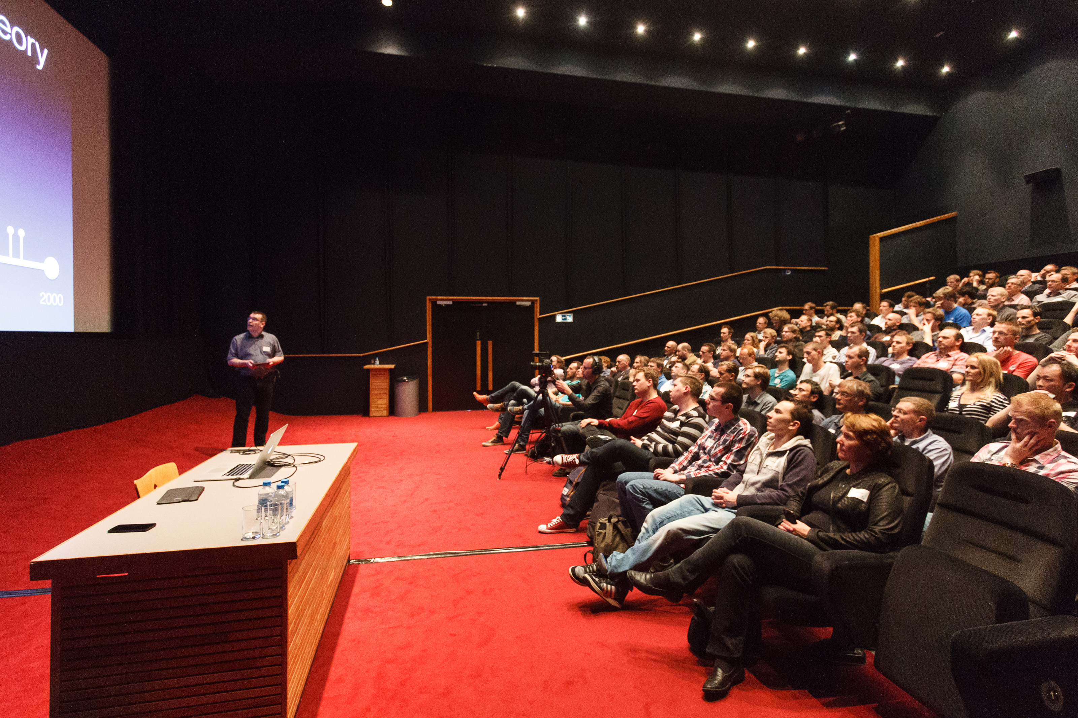


About me
Frank Folsche
Software engineer at Luminis Arnhem
Full-Stack .Net developer
W: frankfolsche.com @: frank.folsche@luminis.eu
2

Slide 3

About me
Steef Burghouts
Software engineer at Luminis Arnhem
Java
Front-end
@: steef.burghouts@luminis.eu
3

Slide 4
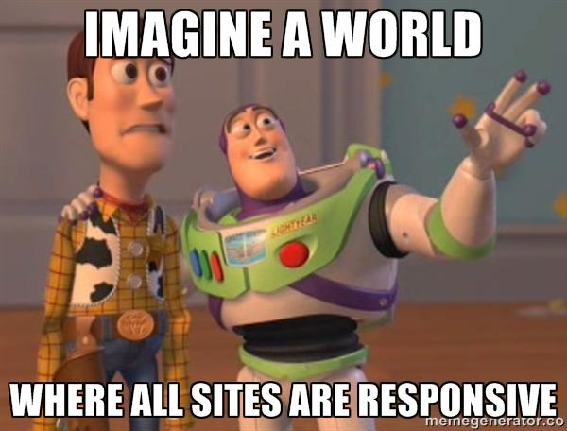
Introduction Why should you build web applications
Crossplatform
Availability
Performance
Usability
Interactivity (async)
Notes:
Als back-end developer is het nu ook interessant geworden
Website voornamelijk vanaf de server gegenereerde pagina. Applicatie die in de browser draait
Crossplatform (mobile nodejs, tradionele browsers)

Slide 5
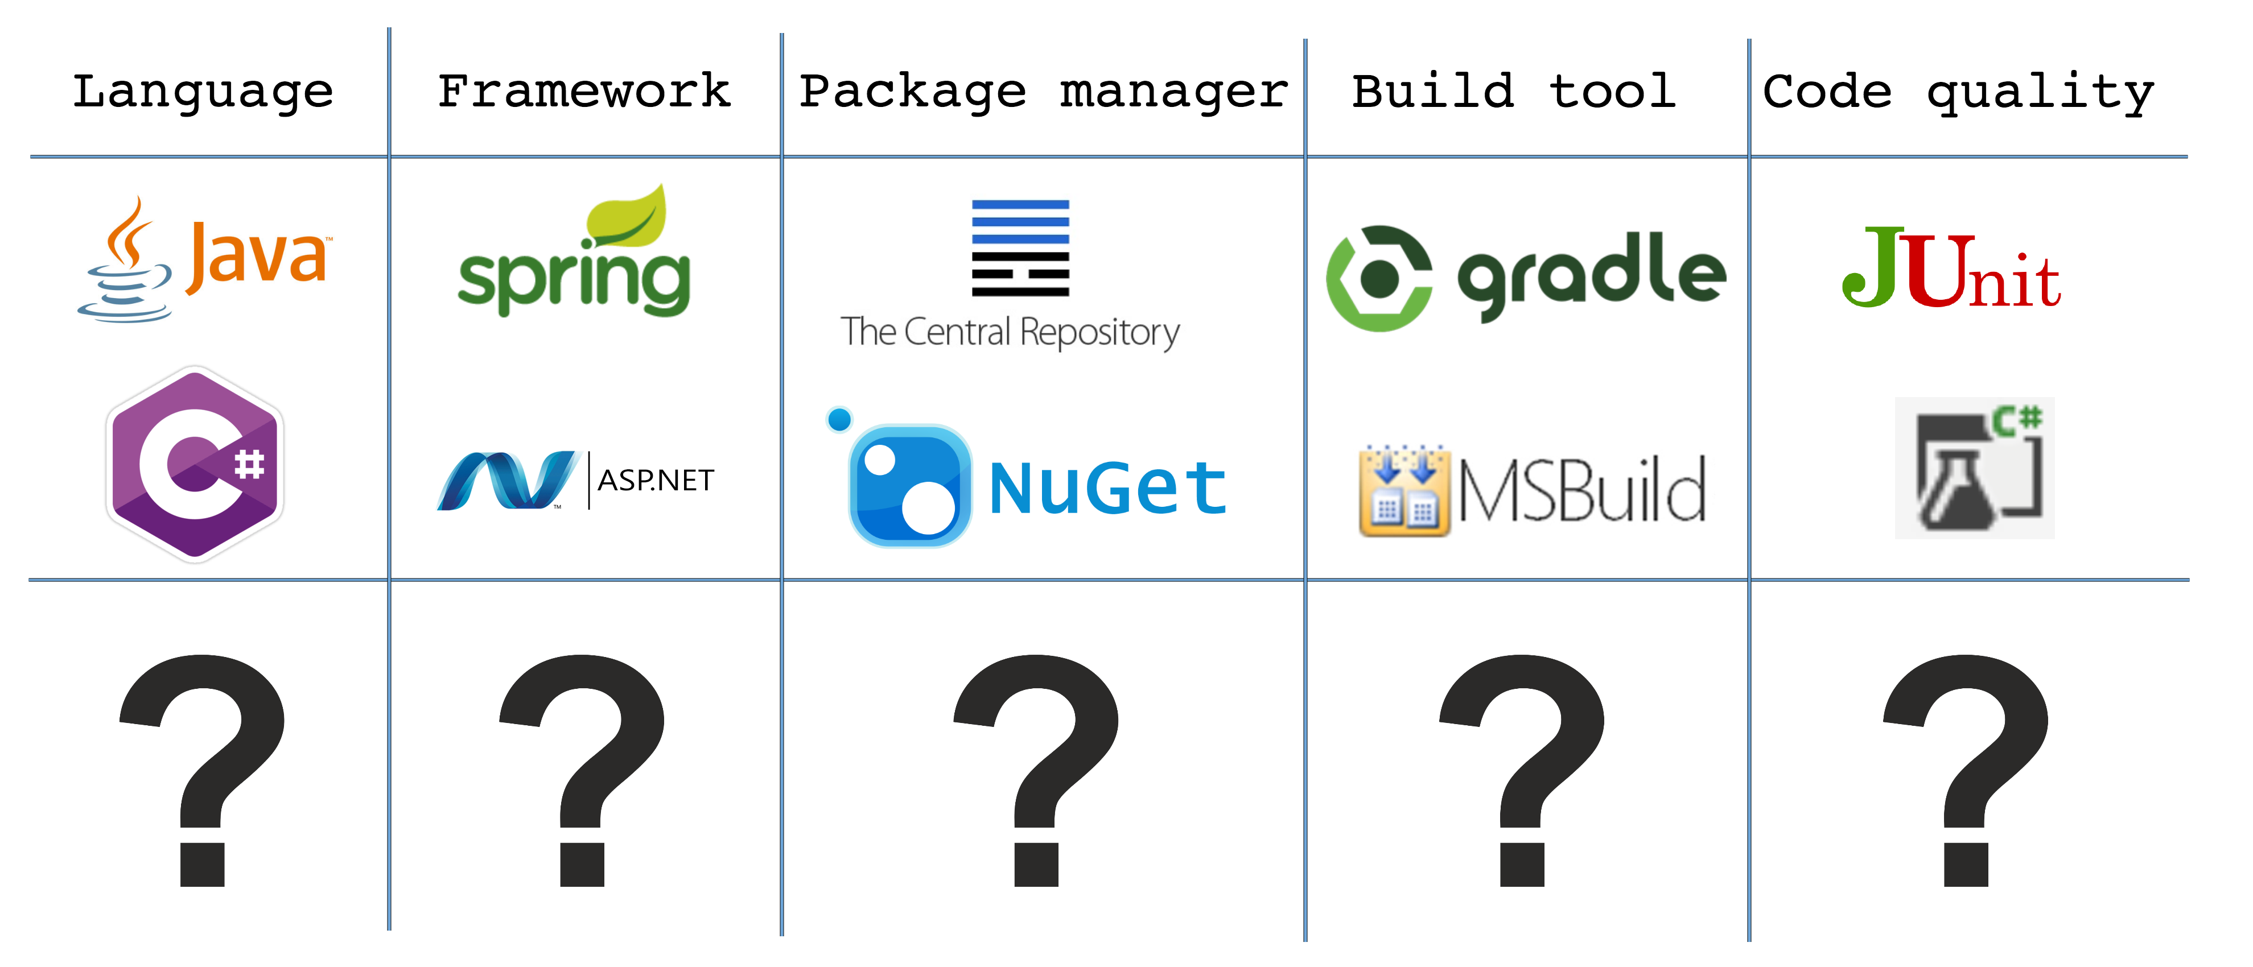
Notes:
Feest van herkenning voor back-end
Stap voor stap de vraagtekens vervangen door front-end technieken

Slide 6
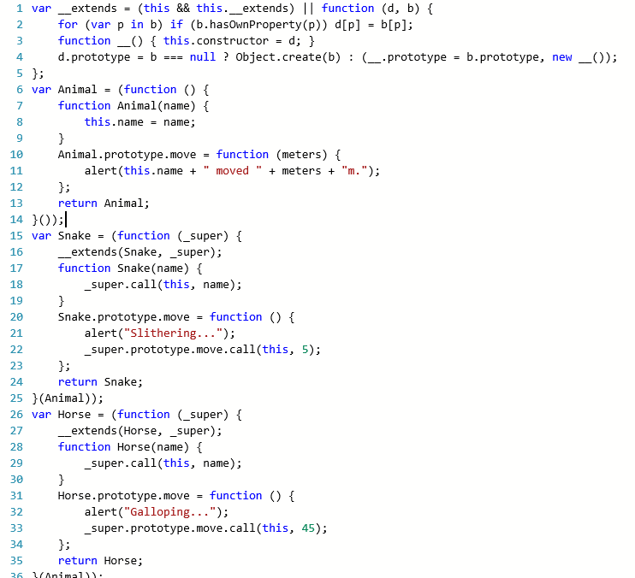
Language I don’t like Javascript…
var a = 1;
function four() {
if (true) {
var a = 4;
}
alert(a); // alerts 4
}
Javascript scopes
Dynamic typing
No modularity
False/Null/undefined/zero/NaN
Math.max() > Math.min()
// ”–Infinity” > “Infinity” returns false
But we need it…
Only scripting language supported by all browsers
Huge amount of libraries
Notes:
Javascript global variables
Strange (sometimes) unpredictable behaviour
No modularity – no information hiding, interfaces between components
(Geen OO paradigma) - immediately invoked function expression (IIFE)
IE support nog vbscript, chromium dart
Javascript scaled helemaal niet
- Dynamic typing maakt een taal een stuk krachtiger, het is met name de tooling en de ontwikkelaar die er veel moeite mee heeft, sterke typering zorgt voor betere tooling

Slide 7
Language The perfect programing language
Javascript ecosystem
A syntax we are familiar with
Object Oriented
Static typing
Modularity
A language that the IDE can understand
Clean Javascript output
Notes:
-Dus we willen geen Javascript, maar wel het Javascript ecosystem -> 150 talen die naar javascript compileren...
- We willen geen hele nieuwe syntax leren; het liefste programmeren we in OO?
- Web applicaties worden steeds groter en daardoor onoverzichtelijker, modulariteit wordt dus steeds belangrijker; seperation of concerns.
- Static typing; met dynamic typing kan je de hele wereld verwachten in een var
- Cleane javascript output, exit strategy

Slide 8



Language Available languages
And 147 other languages that compile to Javascript…
Notes:
https://github.com/jashkenas/coffeescript/wiki/List-of-languages-that-compile-to-JS
Typescript: Microsoft Anders Hejlsberg OO subset Javascript
Coffeescript: Lijkt op ruby, python en haskall; voegt static typing toe
Dart: Dartium library is used at runtime
Dart is a general-purpose programming language originally developed by Google and later approved as a standard by Ecma (ECMA-408).^{[4]} It is used to build web, server and mobile applications, and for Internet of Things (IoT) devices.^{[5]} It is open-source software under a BSD license.
Dart is a class-based, single inheritance, object-oriented language with C-style syntax which compiles into JavaScript or native code. It supports interfaces, mixins, abstract classes, reified generics, and optional typing.

Slide 9

Language Typescript
Superset Javascript
Optionally typed
Object Oriented
Module system
IDE's support us with suggestions
Based on ECMAScript 6
Notes:
Superset Javascript -> compiles to ES3/ES5/ES6 javascript -> do not need any special runtime
Based on ECMAScript 6 > Typescript implements features on next ECMA script releases
By Microsoft, angular by google
Angular 2 written in Typescript

Slide 10
Language Typescript – superset of Javascript
Valid javascript is valid typescript
Use of Javascript ecosystem
Notes:
Skip?
TSC is de typescript compile. De compiler doet niks met de javascript. Sterker nog, hij geeft warnings als er problemen zijn in de code

Slide 11
Language Typescript – optionally typed
A bit of Javascript...
A bit of Typescript…
var count: string = 123; count.toUpperCase();
var count = 123; count.toUpperCase();
var count = 123;
count.toUpperCase();
Runtime:
count.toUpperCase is not a function
Compile-time:
Type 'number' is not assignable to type 'string'.
Compile-time:
Property 'toUpperCase' does
not exist on type 'number'.
Notes:
type inference
Detect errors earlier in the proces

Slide 12

Language Typescript – Familiar syntax
http://www.typescriptlang.org/Playground
Notes:
Refactor “classic javascript” to typescript:
class Greeter {
constructor(public greeting: string) {}
public greet(): string {
return "hello " + this.greeting;
}
}
class SadGreeter extends Greeter {
public greet(): string {
return "bye " + this.greeting;
}
}
let greeter = new Greeter("world");

Slide 13
Language Typescript – Module system
Namespaces
Access identifiers
Information hiding
namespace People {
export class PeopleController {
public someVariable: string;
constructor() {
this.someVariable = "initial value";
}
public setSomeVariable() {
this.someVariable = "something";
}
}
}
let hans = new People.PeopleController();
Notes:
Namespaces are simply named JavaScript objects in the global namespace.
Everything in a class is public if not specified. Everything in a module is private unless export keyword is used.

Slide 14
Language Typescript – Javascript ecosystem
DefinitelyTyped files adds static typing to javascript
https://github.com/DefinitelyTyped/DefinitelyTyped
Notes:
skip?
Typescript “interface” for javascript libraries

Slide 15
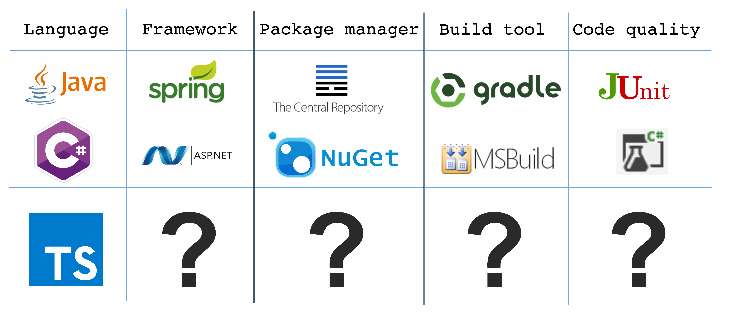

Slide 16
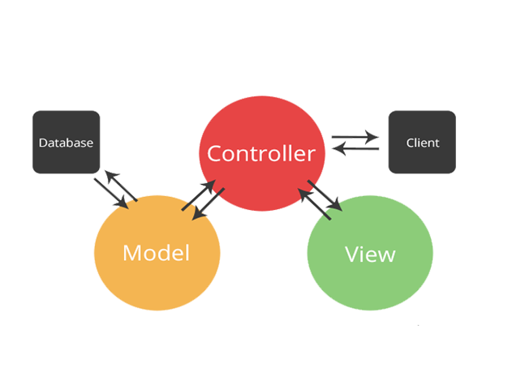
Framework Server side Web MVC framework
Notes:
Conventional MVC frameworks require to do a roundtrip to the server at every state change. Not very responsive and doesn’t create a fluid experience.

Slide 17
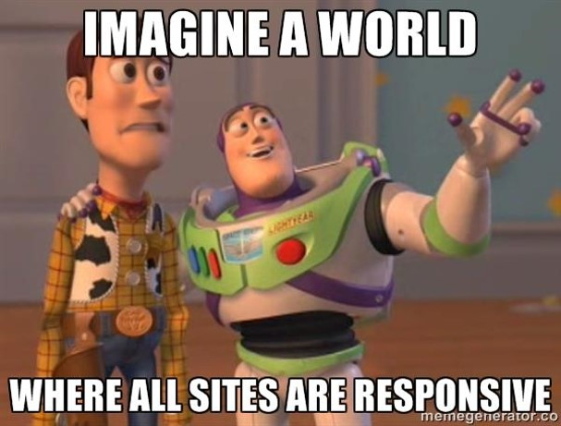
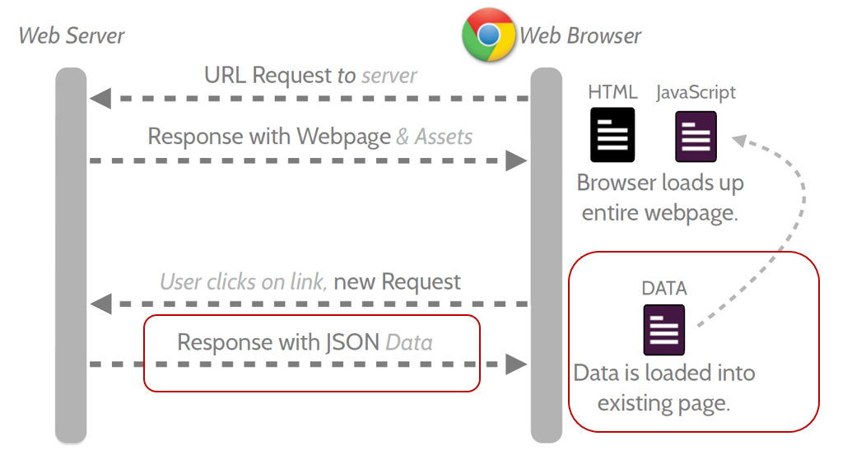
Framework SPA framework
Single Page Application is a web app in which the majority of interactions are handled on the client without the need to reach a server, with a goal of providing a more fluid user experience
Notes:
To relax from all those roundtrips, the SPA framework is introduced
All the UI logic is executed on the client.
iedere keer als een mvc server side app data nodig had, heeft de spa app dat ook. Het verschil is dat er geen hele roundtrip gedaan wordt waardoor er minder data heen en weer gaat.

Slide 18




Framework SPA framework
Notes:
Angular -> spinoff van google
Knockout -> Microsoft data binding
EmberJS -> vergelijkbaar met angular -> jquery handlebars
Backbone.js > jquery, handlebars

Slide 19
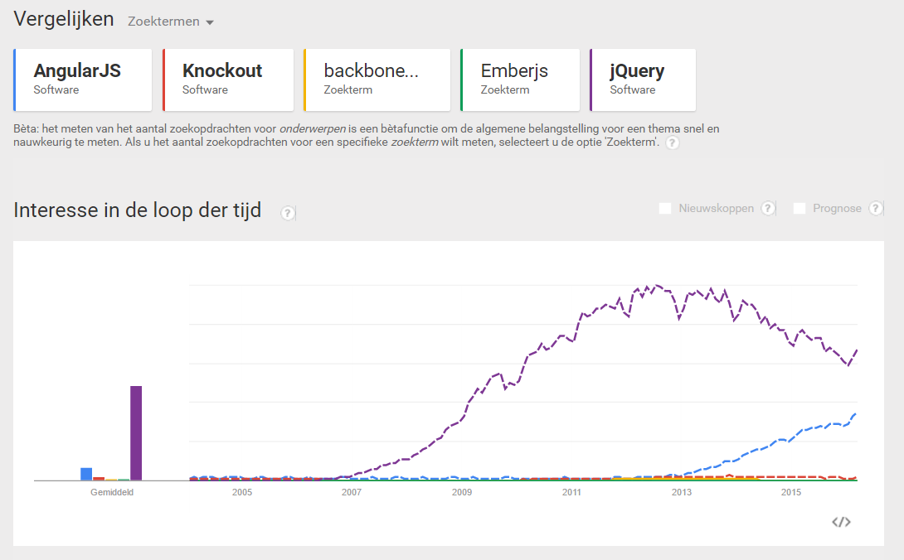
Framework SPA framework
Github stars
AngularJS: 47.921
Backbone: 24.390
EmberJS: 15.900
Knockout: 7.277
jQuery: 38.600
Notes:
jQuery = library, Angular = framework. Angular wordt geleverd met jQuery light.
Angular stands out from the rest in popularity

Slide 20
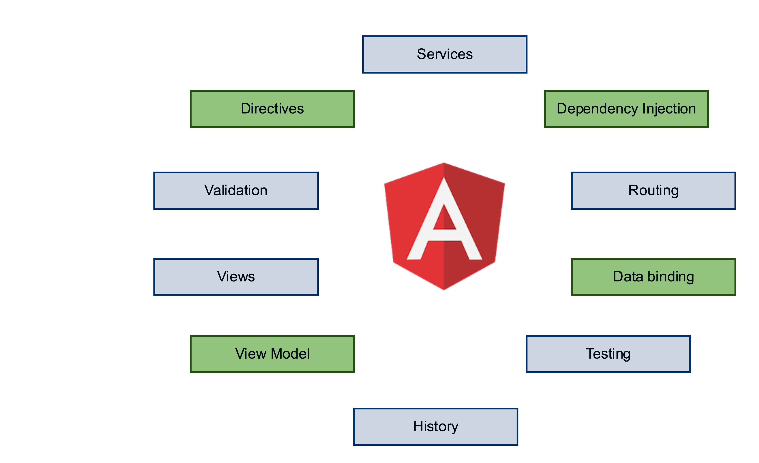

Framework AngularJS
AngularJS is a feature rich MVW Framework
Suitable for large web applications
Extends HTML
Two way data binding
Cross-browser compatible
Testable from the ground up
Notes:
Model-View-Whatever
MVC - MVVW – MVP
First MVC -> more going towards MVVM because of the refactoring op the $scope API. After many discussions the team declared it as MVW -> whatever suits you
IE 9 (2011) >
- It is a very good idea to decouple DOM manipulation from app logic. This dramatically improves the testability of the code.
- It is a really, really good idea to regard app testing as equal in importance to app writing. Testing difficulty is dramatically affected by the way the code is structured.
- It is an excellent idea to decouple the client side of an app from the server side. This allows development work to progress in parallel, and allows for reuse of both sides.
- It is very helpful indeed if the framework guides developers through the entire journey of building an app: From designing the UI, through writing the business logic, to testing.
It is always good to make common tasks trivial and difficult tasks possible.

Slide 21
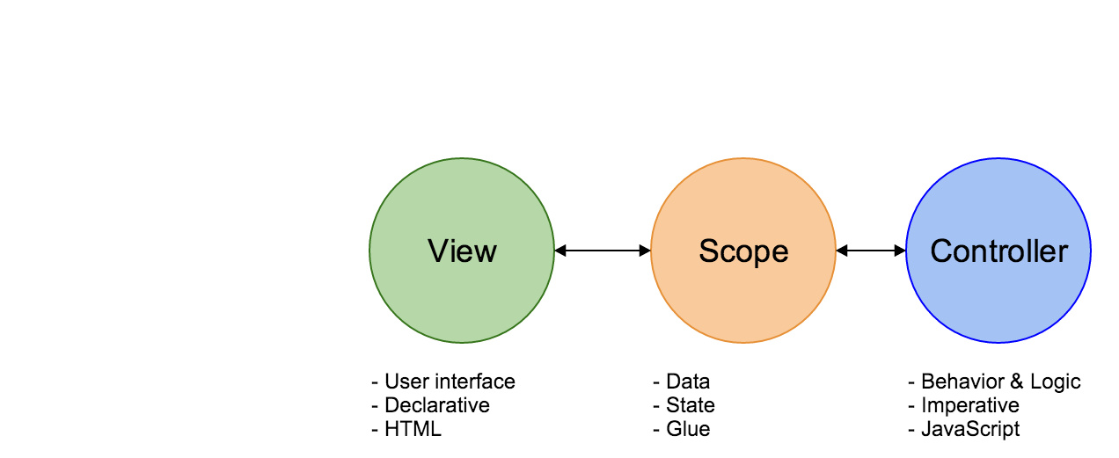
Framework AngularJS
Model-View-Whatever framework
Notes:
Like I said earlier, the framework consists of 3 important parts
View -> Views containing HTML and declarative
Scope -> glueing the view with the rest of the application code > two-way-databinding.
Declerative: state the what
Imperative: state the how

Slide 22
Framework AngularJS - Directives
Directives are markers on a DOM element (such as an attribute, element name, comment or CSS class) that tell AngularJS to attach a specified behavior to that DOM element (e.g. via event listeners), or even to transform the DOM element and its children.
<table class="table table-striped">
<tr ng-repeat="talk in ctrl.talks">
<td> {{ talk.title }} </td>
</tr>
</table>
Notes:
Te veel?
Dingen die opvallen:
Extra elementen op DOM elementen
Presentatie logica naar html
De {{ }} syntax
De appModule -> SPA alle modules worden op die manier geladen
Combinatie typescript – angularJS
The way the Controller as syntax works (since AngularJS 1.2), is by binding the Controller to the current $scope

Slide 23
Framework AngularJS – Dependency injection
Module dependency
angular.module(" devcon", ["talk"]);
Register service dependency
Register module
let talkModule: angular.IModule = angular.module("talk",[]);
talkModule.service("talkService", TalkService);
Inject service dependency
export class TalkController {
constructor(public talkService: TalkService){}
}
Notes:
Dingen die opvallen:
Inject van ui.router library
Creation of dependencies to the module
- Separate the process of creation and consumption of dependencies
- Let the consumer worry only about how to use the dependency, and leave the process of creation of the dependency to somebody else
- Allow concurrent/independent development of the dependency and the dependent entity, while only maintaing a known contract
- Facilitate changing of the dependencies when needed

Slide 24
Framework AngularJS – Two way data binding
$scope is the glue for two way data binding!
namespace Talk {
interface TalkScope extends angular.IScope {
title: string;
}
export class TalkController {
public title: "Talks";
constructor(public $scope: TalkScope) {
this.$scope.title = this.title;
}
}
}
<input type="text" ng-model="title" /> <h1> {{title }} </h1>
Notes:
Two way data binding zorgt ervoor dat zowel changes vanuit de view als changes vanuit het model gelijk in de view zichtbaar zijn
$scope is een variabele waarin je gegevens kan zetten die zo in de view
MODEL IS THE SINGLE POINT OF TRUTH

Slide 25
Language Angular demo
Notes:
public getTalks() {
this.talkService.getAllTalks().then((talks: Talk[]) => { t
his.talks = talks;
});
}
public talks: Talk[];
Public title: string;
this.getTalks();
This.title = “Talks”
<h2>{{ ctrl.title }}</h2>
<table class="table table-striped">
<tr ng-repeat="talk in ctrl.talks">
<td> {{ talk.title }} <td>
</tr>
</table>

Slide 26
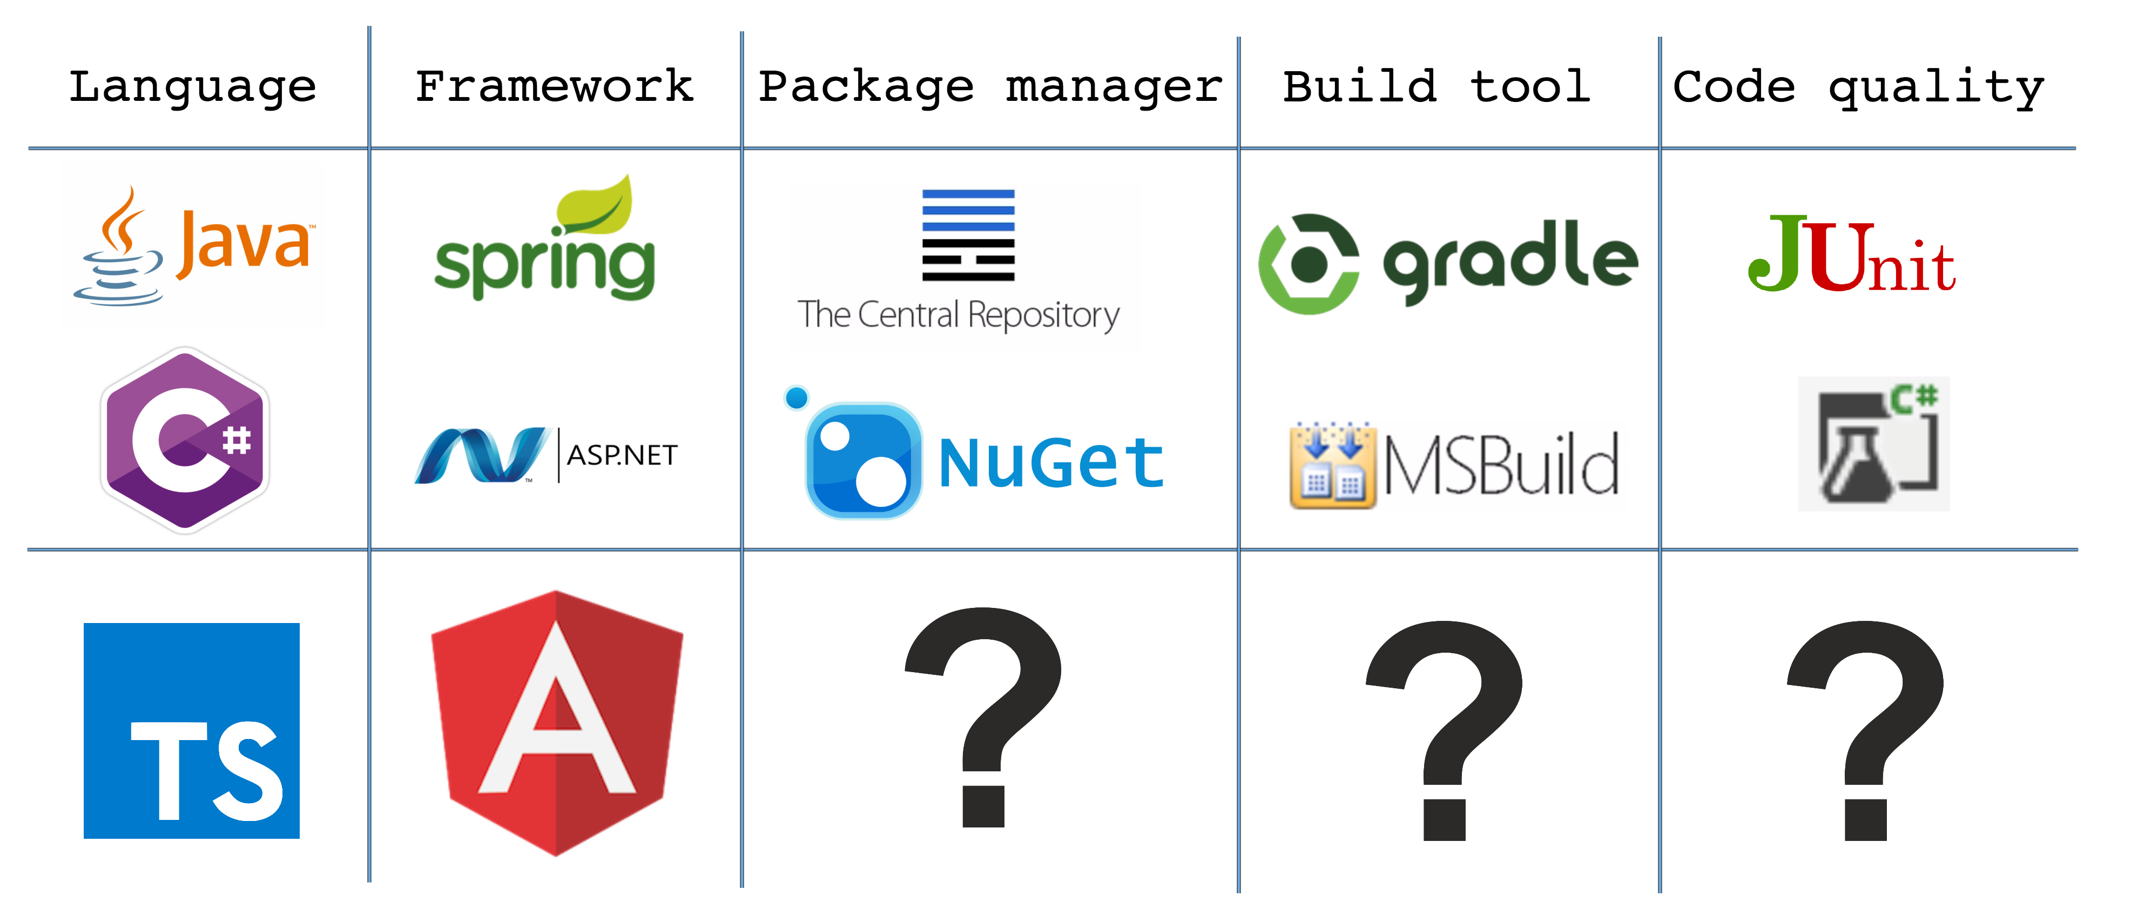

Slide 27




Managing packages
Why reinvent the wheel?
NuGet
Maven Central
Npm
Bower
Notes:
Npm van nodejs en server side packages zoals je build tools
Bower front-end depencies zoals angular
maven je build en je packages in een front-end los

Slide 28
Managing packages Bower
Bower Front-end dependencies
init
install
uninstall
update
{
"name": "Devcon Webdev",
"version": "0.1.1",
"dependencies": {
"angular": "1.4.8",
"angular-ui-router": "0.2.15",
"bootstrap": "^3.3.6“
},
"devDependencies": {
"angular-mocks": "^1.5.0"
}
}
Hosted at
Bower Registery
Github
Subversion
Local file path
Single files or a zip
bower.json
Notes:
What kind of packages
Npm only dev dependencies because we don’t have any production server code we only use it for the build process
Bower very little -dev

Slide 29
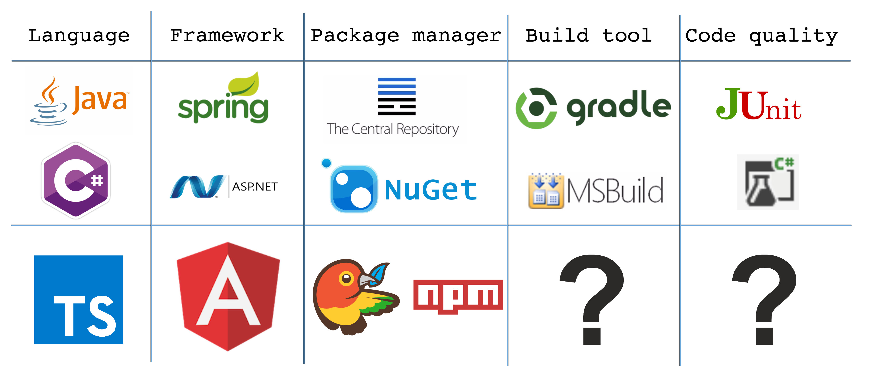

Slide 30
Build process Why would we want a build process
Reducing repetitiveness
Compile
Optimizing for production
Analyze
Notes:
Why you don’t have to build javascript, just keep development and production the same.
Hier Msbuild Ant en Maven enzo noemen

Slide 31
Build process Why would we want a build process
Organize your files
Minify
Concat
Debug Typescript Sourcemaps
Running Tests
Code styles
Reload website on change And many many more
Notes:
Why you don’t have to build javascript, just keep development and production the same.

Slide 32

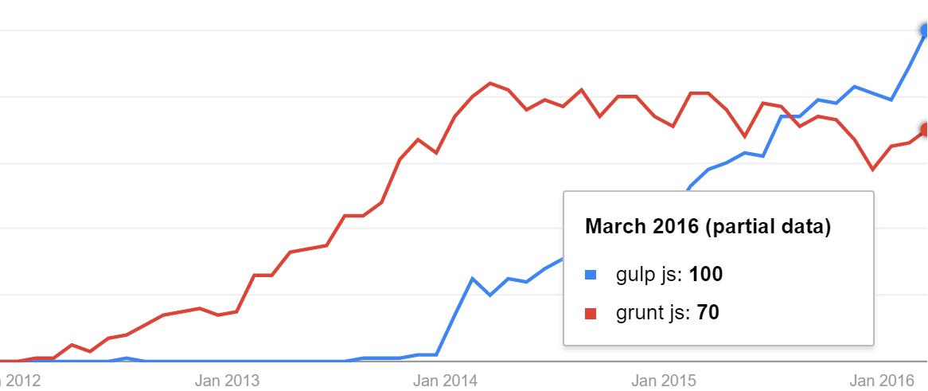
Build process Grunt vs Gulp
 | Grunt | Gulp
Plugins | 5500 results for ‘grunt’ | 2200 results for ‘gulp’
Method | File copy | Stream
 | Configure | Code
Notes:
Why you don’t have to build javascript, just keep development and production the same. Grunt just release stable version la

Slide 33
Build process Gulp
1 file
gulpfile.js in de project root
Task
Src
Pipe
Dest
Watch
5 functions
Runs in Nodejs
Installed using NPM
Notes:
Why you don’t have to build javascript, just keep development and production the same.

Slide 34
Build process Gulp - Task
/**
* Copy and concat libraries
* @return {Stream}
*/ gulp.task('build-libs',['clean'], function () { });
Notes:
sass is een subset van CSS dat compiled naar css
Why you don’t have to build javascript, just keep development and production the same.
Call back function

Slide 35

Build process Gulp - Src
/**
* Copy and concat libraries
* @return {Stream}
*/ gulp.task('build-libs', function (done) {
return gulp.src('libs/**/*.js')
});
Glob or array of globs for pattern matching
* wildcard
Notes:
Why you don’t have to build javascript, just keep development and production the same.

Slide 36
Build process Gulp - Pipe
var concat = require('gulp-concat');
/**
* Copy and concat libraries
* @return {Stream}
*/ gulp.task('build-libs', function (done) {
return gulp.src('libs/**/*.js ')
.pipe(concat('libs.js'))
});
Use plugins to modify the files in the stream
Notes:
Compile SCSS????
Why you don’t have to build javascript, just keep development and production the same.

Slide 37
Build process Gulp - Dest
var concat = require('gulp-concat');
/**
* Copy and concat libraries
* @return {Stream}
*/ gulp.task('build-libs', function () {
return gulp.src('libs/**/*.js ')
.pipe(concat('libs.js'))
.pipe(gulp.dest('/build'))
});
Writes the files in de stream to a destination
Notes:
Why you don’t have to build javascript, just keep development and production the same.

Slide 38
Build process Gulp - Watch
/**
* watches for changes and rebuilds sepecific parts
* @return {Stream}
*/
gulp.task('watch-libs',['build-libs'], function () {
gulp.watch('libs/**/*.js ', ['build-libs']);
});
Watches a glob pattern and runs a task if there are changes
Notes:
Short on time skip
Why you don’t have to build javascript, just keep development and production the same.

Slide 39
Demo Time
Bower
Gulp
Notes:
Why you don’t have to build javascript, just keep development and production the same.

Slide 40
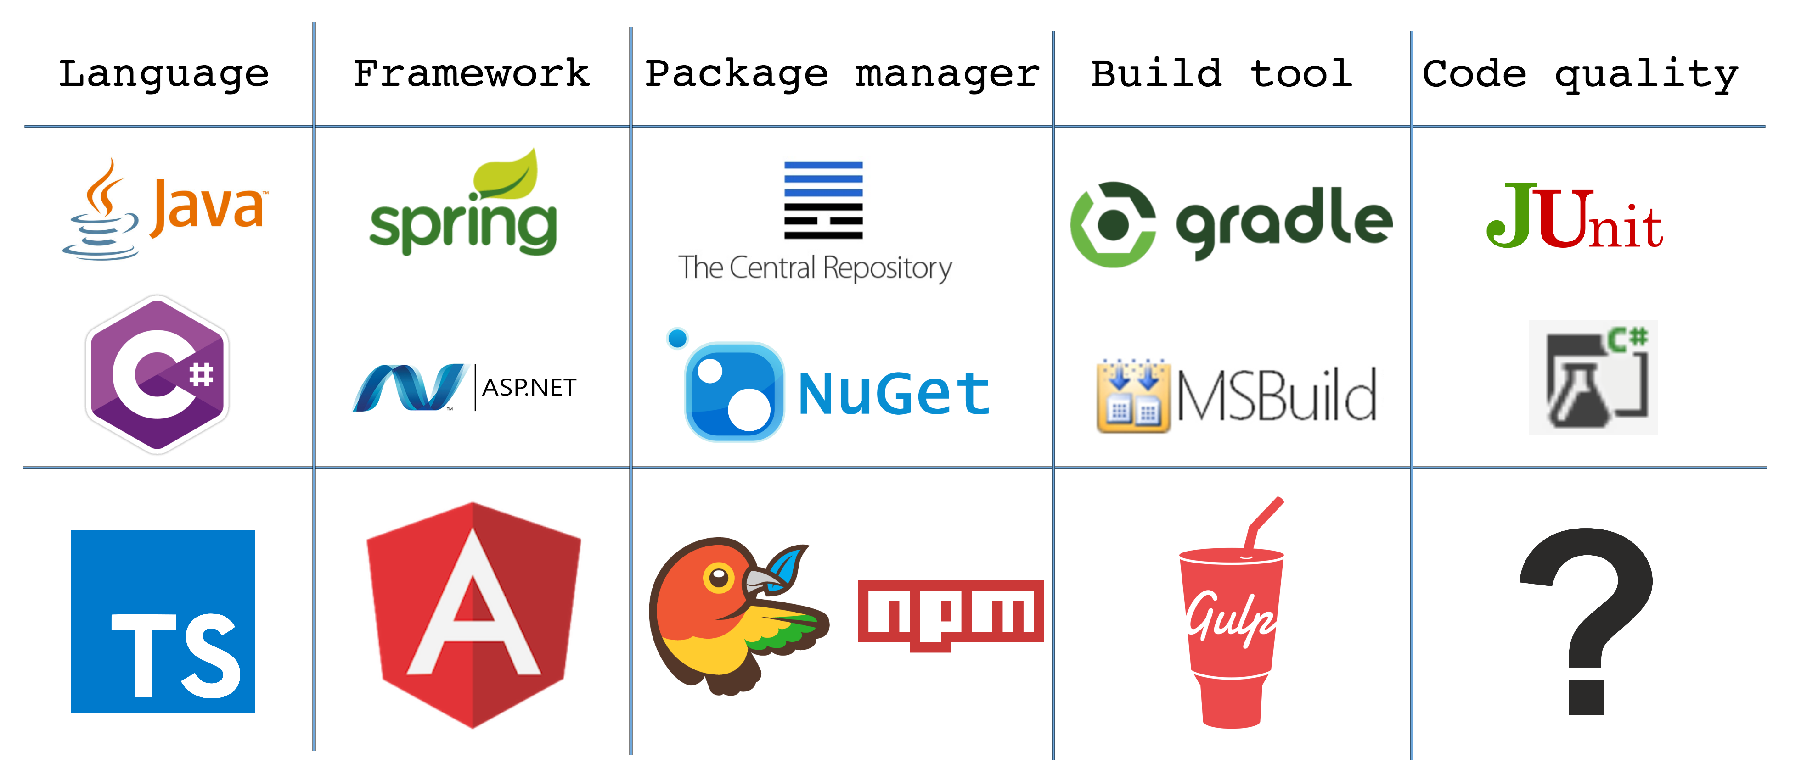

Slide 41



Code Quality Unit testing
Front-end code more and more business logic
Mobile apps written in javascript
Frameworks
Test runner: Karma
Testing framework: Jasmine
Mocking framework: Angular mock
Notes:
plaatje NG mock
Why you don’t have to build javascript, just keep development and production the same.
Recommended by angular (jasmine karma)
Karma is created by the angular team
Angular is designed with testing in mind, specially for that they designed angular mocks

Slide 42




Code Quality Unit testing - Karma
Run your tests automated.
Almost any browser.
Can be started from Gulp
Notes:
Karma genereert een html pagina die je test libraries en je tests laad
PhantomJS headless scriptable browser
Run tests on change
Preprocessing.

Slide 43
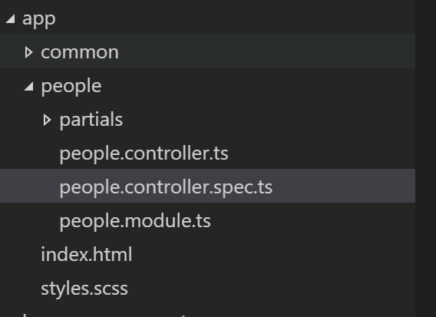
Code Quality Unit testing – Spec files
Usually we place tests right next to the file you want to test.
Different from Java or C# where you probably have you tests grouped together
Notes:
Skip?

Slide 44
Code Quality Unit testing – Jasmine
BDD Behavior Driven Development
describe
beforeEach
it
expect
describe("talkController", function () {
let controller;
beforeEach(() => {
controller = new Talk.TalkController();
});
it("Should toggle the variable", () => {
controller.toggle();
expect(controller.toggle).toEqual(false);
});

Slide 45
Code Quality Unit testing – Mocking angular
3 public functions:
module
Used to load modules
inject
Used to get instances of components
dump
Serializes common objects for debugging
beforeEach(angular.mock.module("talk"));
let talkService: Talk.ITalkService;
let $httpBackend: angular.IHttpBackendService;
beforeEach(angular.mock.inject((_talkService_, _$httpBackend_) => {
talkService = _talkService_;
$httpBackend = _$httpBackend_;
}));
$httpBackend.when("GET", urlConfig + "talks").respond(500);
console.log(angular.mock.dump(talkService));
Notes:
Why you don’t have to build javascript, just keep development and production the same.

Slide 46
Code Quality Style checking
jSLint
tSLint
Code guidelines for your team
Notes:
Why you don’t have to build javascript, just keep development and production the same.

Slide 47
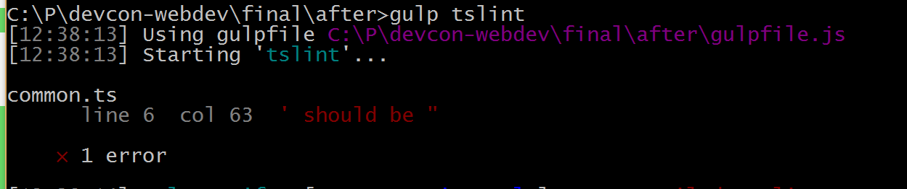
Code Quality Style checking
{
"rules": {
"quotemark": [ true, "double", "avoid-escape" ]
}
}
namespace Common {
const name = "devcon-webdev";
let app: angular.IModule = angular.module(name, ['templates', "ui.router", "people"]);
}
47
Notes:
Why you don’t have to build javascript, just keep development and production the same.

Slide 48
Demo Time
Testing
TSLint
Notes:
Why you don’t have to build javascript, just keep development and production the same.

Slide 49
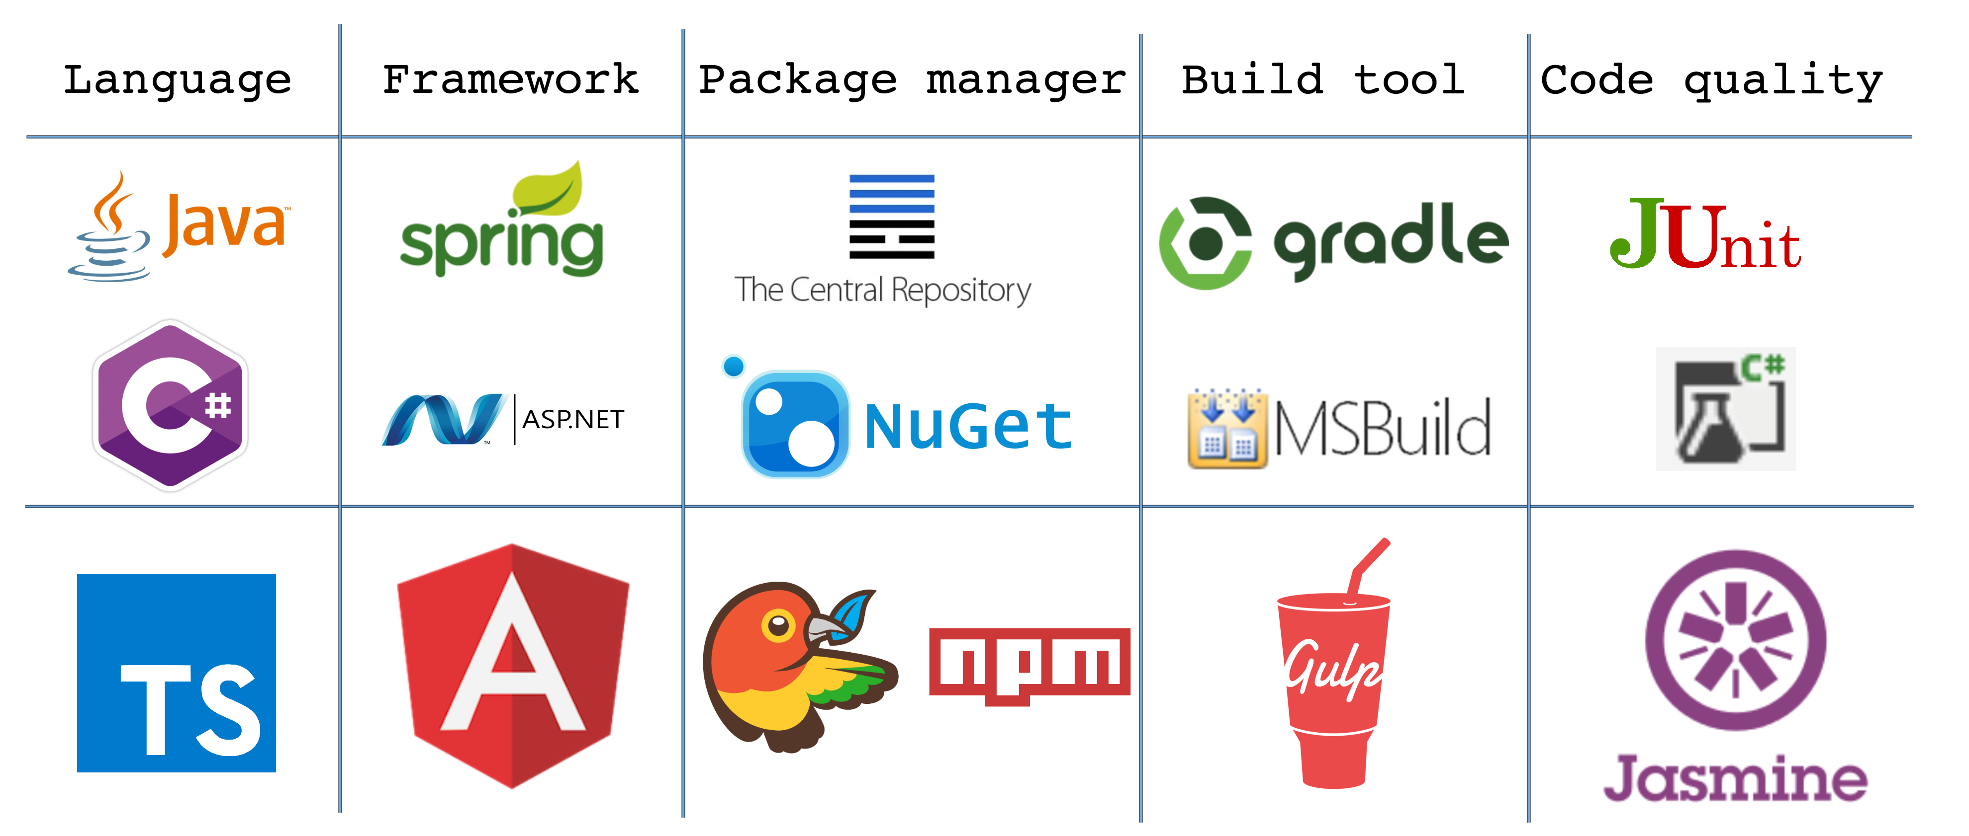
Notes:
Front-end vs backend

Slide 50

?
is powered by
Thank you
Any
Questions?
Github: http://lumin.is/webdev
Frank.Folsche@luminis.eu
Steef.Burghouts@luminis.eu
In theory, there is no difference between theory and practice. But, in practice, there is.

